Slide 1
Transactions
Non-Serializable

Slide 2
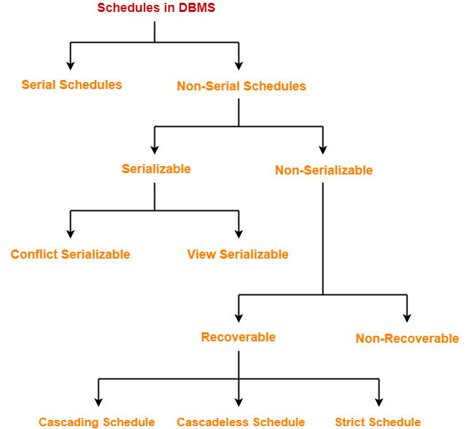
Next: Non-Serializable Schedules

Slide 3
B. Non-Serializable Schedules-
A non-serial schedule which is not serializable is called as a non-serializable schedule.
A non-serializable schedule is not guaranteed to produce the same effect as produced by some serial schedule on any consistent database.
Characteristics-
Non-serializable schedules-
may or may not be consistent
may or may not be recoverable

Slide 4
Irrecoverable Schedules-
If in a schedule,
A transaction performs a dirty read operation from an uncommitted transaction
And commits before the transaction from which it has read the value
then such a schedule is known as an Irrecoverable Schedule.

Slide 5
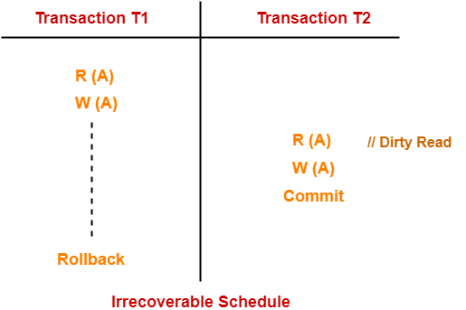
Example-
Consider the following schedule-
T2 performs a dirty read operation.
T2 commits before T1.
T1 fails later and roll backs.
The value that T2 read now stands to be incorrect.
T2 can not recover since it has already committed.

Slide 6
Recoverable Schedules-
If in a schedule,
A transaction performs a dirty read operation from an uncommitted transaction
And its commit operation is delayed till the uncommitted transaction either commits or roll backs
then such a schedule is known as a Recoverable Schedule.
Here,
The commit operation of the transaction that performs the dirty read is delayed.
This ensures that it still has a chance to recover if the uncommitted transaction fails later.

Slide 7
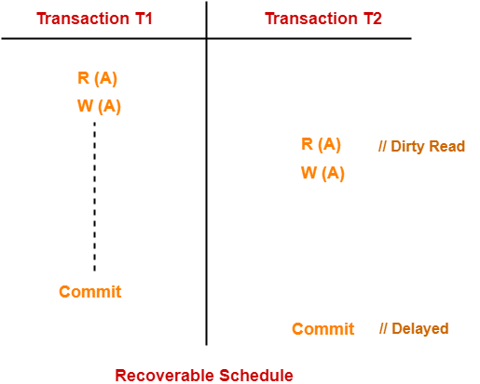
Example-
Consider the following schedule-
Here,
T2 performs a dirty read operation.
The commit operation of T2 is delayed till T1 commits or roll backs.
T1 commits later.
T2 is now allowed to commit.
In case, T1 would have failed, T2 has a chance to recover by rolling back.

Slide 8
Checking Whether a Schedule is Recoverable or Irrecoverable-
Method-01:
Check whether the given schedule is conflict serializable or not.
If the given schedule is conflict serializable, then it is surely recoverable. Stop and report your answer.
If the given schedule is not conflict serializable, then it may or may not be recoverable. Go and check using other methods.
Thumb Rules
All conflict serializable schedules are recoverable.
All recoverable schedules may or may not be conflict serializable.

Slide 9
Method-02:
Check if there exists any dirty read operation.
(Reading from an uncommitted transaction is called as a dirty read)
If there does not exist any dirty read operation, then the schedule is surely recoverable. Stop and report your answer.
If there exists any dirty read operation, then the schedule may or may not be recoverable.
If there exists a dirty read operation, then follow the following cases-

Slide 10
Case-01:
If the commit operation of the transaction performing the dirty read occurs before the commit or abort operation of the transaction which updated the value, then the schedule is irrecoverable.
Case-02:
If the commit operation of the transaction performing the dirty read is delayed till the commit or abort operation of the transaction which updated the value, then the schedule is recoverable.
Thumb Rule
No dirty read means a recoverable schedule.

Slide 11
We have discussed-
Non-serial schedules which are not serializable are called as non-serializable schedules.
Non-serializable schedules may be recoverable or irrecoverable.

Slide 12
Recoverable Schedules-
If in a schedule,
A transaction performs a dirty read operation from an uncommitted transaction
And its commit operation is delayed till the uncommitted transaction either commits or roll backs
then such a schedule is called as a Recoverable Schedule.

Slide 13
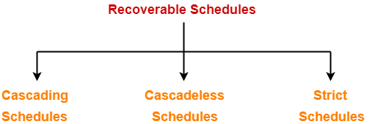
Types of Recoverable Schedules-
A recoverable schedule may be any one of these kinds-

Slide 14
Cascading Schedule-
If in a schedule, failure of one transaction causes several other dependent transactions to rollback or abort, then such a schedule is called as a Cascading Schedule or Cascading Rollback or Cascading Abort.
It simply leads to the wastage of CPU time.

Slide 15
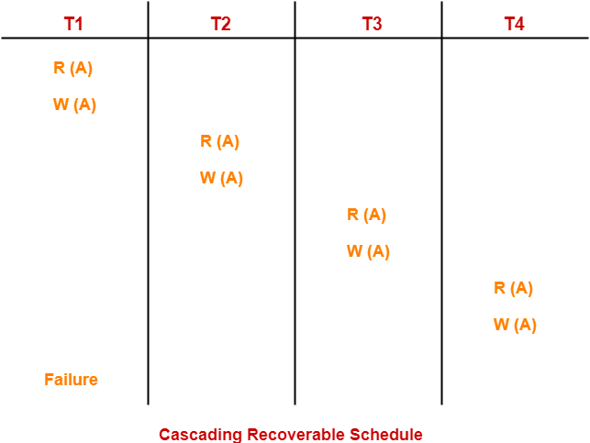
Here,
Transaction T2 depends on transaction T1.
Transaction T3 depends on transaction T2.
Transaction T4 depends on transaction T3.
In this schedule,
The failure of transaction T1 causes the transaction T2 to rollback.
The rollback of transaction T2 causes the transaction T3 to rollback.
The rollback of transaction T3 causes the transaction T4 to rollback.
Such a rollback is called as a Cascading Rollback.
NOTE-
If the transactions T2, T3 and T4 would have committed before the failure of transaction T1, then the schedule would have been irrecoverable.

Slide 16
Cascadeless Schedule-
If in a schedule, a transaction is not allowed to read a data item until the last transaction that has written it is committed or aborted, then such a schedule is called as a Cascadeless Schedule.
In other words,
Cascadeless schedule allows only committed read operations.
Therefore, it avoids cascading roll back and thus saves CPU time.

Slide 17
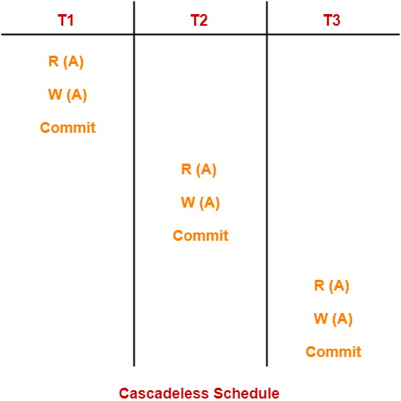
Example-
NOTE-
Cascadeless schedule allows only committed read operations.
However, it allows uncommitted write operations.

Slide 18
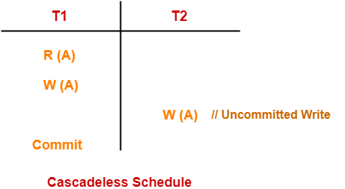
Example-

Slide 19
Strict Schedule-
If in a schedule, a transaction is neither allowed to read nor write a data item until the last transaction that has written it is committed or aborted, then such a schedule is called as a Strict Schedule.
In other words,
Strict schedule allows only committed read and write operations.
Clearly, strict schedule implements more restrictions than cascadeless schedule.

Slide 20
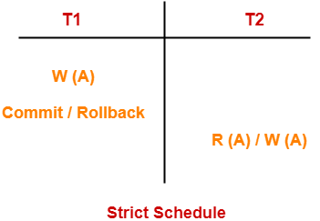
Example-

Slide 21
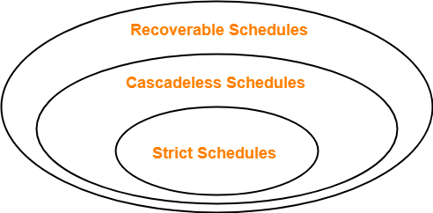
Points to Remember
Strict schedules are more strict than cascadeless schedules.
All strict schedules are cascadeless schedules.
All cascadeless schedules are not strict schedules.

Slide 22
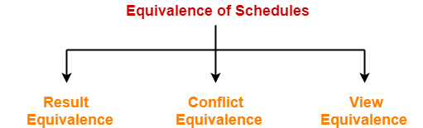
Equivalence of Schedules-
In DBMS, schedules may have the following three different kinds of equivalence relations among them-
Result Equivalence
Conflict Equivalence
View Equivalence

Slide 23
1. Result Equivalent Schedules-
If any two schedules generate the same result after their execution, then they are called as result equivalent schedules.
This equivalence relation is considered of least significance.
This is because some schedules might produce same results for some set of values and different results for some other set of values.

Slide 24
2. Conflict Equivalent Schedules-
If any two schedules satisfy the following two conditions, then they are called as conflict equivalent schedules-
The set of transactions present in both the schedules is same.
The order of pairs of conflicting operations of both the schedules is same.

Slide 25
3. View Equivalent Schedules-
Already discussed.

Slide 26
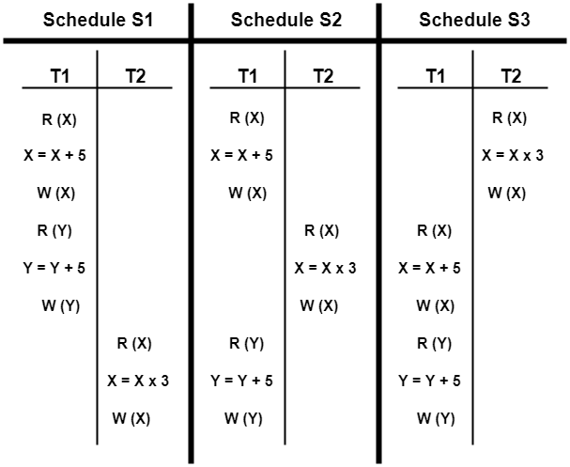
PRACTICE PROBLEMS BASED ON EQUIVALENCE OF SCHEDULES-
Problem-01:
Are the following three schedules result equivalent?
Assume:
X=2
Y=5

Slide 27
Solution-
To check whether the given schedules are result equivalent or not,
We will consider some arbitrary values of X and Y.
Then, we will compare the results produced by each schedule.
Those schedules which produce the same results will be result equivalent.
Let X = 2 and Y = 5.
On substituting these values, the results produced by each schedule are-
Results by Schedule S1- X = 21 and Y = 10
Results by Schedule S2- X = 21 and Y = 10
Results by Schedule S3- X = 11 and Y = 10
Clearly, the results produced by schedules S1 and S2 are same.
Thus, we conclude that S1 and S2 are result equivalent schedules.

Slide 28
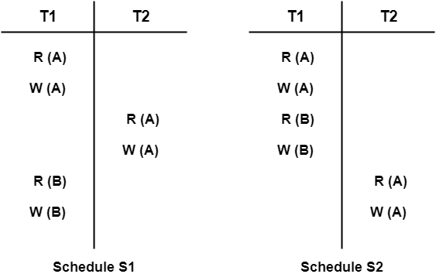
Problem-02:
Are the following two schedules conflict equivalent?

Slide 29
Solution-
To check whether the given schedules are conflict equivalent or not,
We will write their order of pairs of conflicting operations.
Then, we will compare the order of both the schedules.
If both the schedules are found to have the same order, then they will be conflict equivalent.

Slide 30
Solution-
For schedule S1-
The required order is-
R₁(A) , W₂(A)
W₁(A) , R₂(A)
W₁(A) , W₂(A)
For schedule S2-
The required order is-
R₁(A) , W₂(A)
W₁(A) , R₂(A)
W₁(A) , W₂(A)
Clearly, both the given schedules have the same order.
Thus, we conclude that S1 and S2 are conflict equivalent schedules.

Slide 31


